Slide 1
DATA WAREHOUSE PROJECT
ACADEMY AWARD OSCAR
1927 -2023
96 Ceremonies · 11,874 Nominations · 3,435 Winners · 1927 – 2023
COURSE
Data Warehouse
DATABASE
SQLite 3, Star Schema, Power BI
GROUP
G06
DATE
6 April 2026
David Pereira Dias (UP201905099)
Manju Srinivasan (UP202510628)
Miguel Filipe Santos (UP202008450)
PRESENTED BY

Slide 2
Contents
Structured walkthrough of the Data Warehouse lifecycle
01
Subject Description & Goals
05
Querying & Data Analysis
Project overview, key dataset facts, and research objectives
15 analytical SQL queries covering nominations, win rates & trends
02
Planning
06
Visualisation
Dimensional Bus Matrix, dimension & fact dictionary
Power BI dashboard — charts, KPI cards, interactive filters
03
Dimensional Data Model
07
Conclusion & Reflection
Operational ER model, Star Schema design, key design decisions
Findings summary, DW vs OLTP advantages, limitations & future work
04
ETL — Extract, Transform, Load
Source file, extraction pipeline, transformations, loading order
02

Slide 3
01 · Subject Description & Goals
Complete Data Warehousing lifecycle for Academy Awards 1927–2023
11,876
3,435
~29%
96
5066+
Total Nominations
Total Winners
Overall Win Rate
Ceremonies
Distinct Films
PROJECT OVERVIEW
PROJECT GOALS
This project designs, builds, and analyses a Data Warehouse centred on the complete historical record of the Academy Awards — the most prestigious prize in the film industry.
The source data covers every Oscar nomination from Ceremony 1 (1927/28) through Ceremony 96 (2023), encompassing 11,876 nominations, 3,435 winners, and diverse categories spanning acting, directing, writing, production, music, documentary, and scientific/technical awards.
The pipeline runs natively in SQLite: raw CSV , normalised operational schema , Star Schema , analytical SQL, Power BI & Python visualisation.
01 Design a robust Star Schema for multi-dimensional nomination and win analysis
02 Implement complete ETL: staging , operational model,Star Schema
03 Develop additive and semi-additive fact tables
04 Enrich dimensions with derived attributes (decade, era, class group)
05 Write 15 analytical SQL queries for business intelligence
06 Build an interactive Power BI dashboard
07 Critically reflect on DW vs OLTP design trade-offs
03

Slide 4
02 · Planning
Dimensional Bus Matrix · Dimensions Dictionary · Facts Dictionary
DIMENSIONAL BUS MATRIX
Fact Table | Grain | dim_ceremony | dim_category | dim_class | dim_film | dim_ nominee
FACT_NOMINATION | Transactional | ✓ | ✓ | ✓ | ✓ | ✓
FACT_CEREMONY_SNAPSHOT | Periodic Snapshot | ✓ | ✓ | ✓ | — | —
DIMENSIONS
FACT TABLES
dim_ceremony 96 rows · ceremony_number, year, decade, era
fact_nomination
Transactional · nom_count (1), win_count (0/1), multifilm flag
dim_category Canonical category · roll-up by CanonicalCategory
fact_ceremony_snapshot
Periodic · total_nominations, total_winners, total_films_nominated, avg_nominees_per_film
dim_class 8 rows · class_name, class_group (Creative/Technical)
dim_film Distinct film · film_id (IMDb tt…), title
bridge_participation
Many-to-many bridge · nom_id × nominee_key
dim_nominee Distinct person/org · nominee_id (IMDb nm…)
04

Slide 5
03 · Dimensional Data Model
Operational ER Model , Star Schema, Key Design Decisions
OPERATIONAL ER MODEL
STAR SCHEMA
DESIGN DECISIONS
Before the Star Schema, an operational relational model normalises the raw staging data.
Start Schema dimensional model with two fact tables and five dimensions:
Bridge Table
Resolves multi-nominee nominations without row duplication in fact
CEREMONY
FACT TABLES
Snapshot Fact
fact_nomination (transactional)
fact_ceremony_snapshot (periodic)
FILM
Pre-aggregates per ceremony/category — faster Power BI queries
DIMENSIONS
CATEGORY
dim_ceremony · dim_category
dim_class · dim_film · dim_nominee
Conformed Dims
dim_ceremony & dim_category shared across both fact tables
NOMINEE
BRIDGE
bridge_participation
resolves many-to-many
Derived Attrs
NOMINATION
decade, century, era computed at ETL — no repeated CASE expressions
ADDITIVE
PARTICIPATION
Degenerate Dim
nomination_count, win_count
total_nominations, total_winners
→ NOMINATION ← CEREMONY (1:many)
nom_id kept as PK; no extra dimension table needed
→ NOMINATION ← FILM (1:many)
SEMI-ADDITIVE
SciTech Class
→ NOMINATION ← CATEGORY (1:many)
total_films_nominated
avg_nominees_per_film
Non-competitive awards isolated to prevent win-rate distortion
→ PARTICIPATION bridges NOMINATION, NOMINEE (many:many)
05

Slide 6
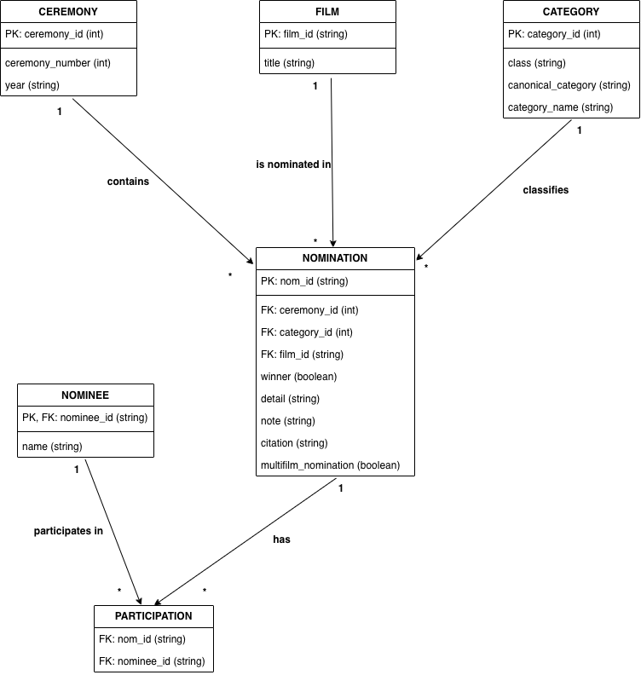
3 Operational Model Entity Relationship Diagram
Operational ER Model , Star Schema, Key Design Decisions
Operational Tables
CEREMONY
96 rows · PK: ceremony_id · year, ceremony_number
FILM
~5,100 rows · film_id (IMDb tt… / ef…) · title
CATEGORY
class + canonical_category + category_name · UNIQUE
NOMINEE
~7,000 rows · nominee_id (IMDb nm…) · name
NOMINATION
11,876 rows · winner 0/1 · FK to ceremony, film, category
PARTICIPATION
Bridge · nom_id ↔ nominee_id · resolves many-to-many
06

Slide 7
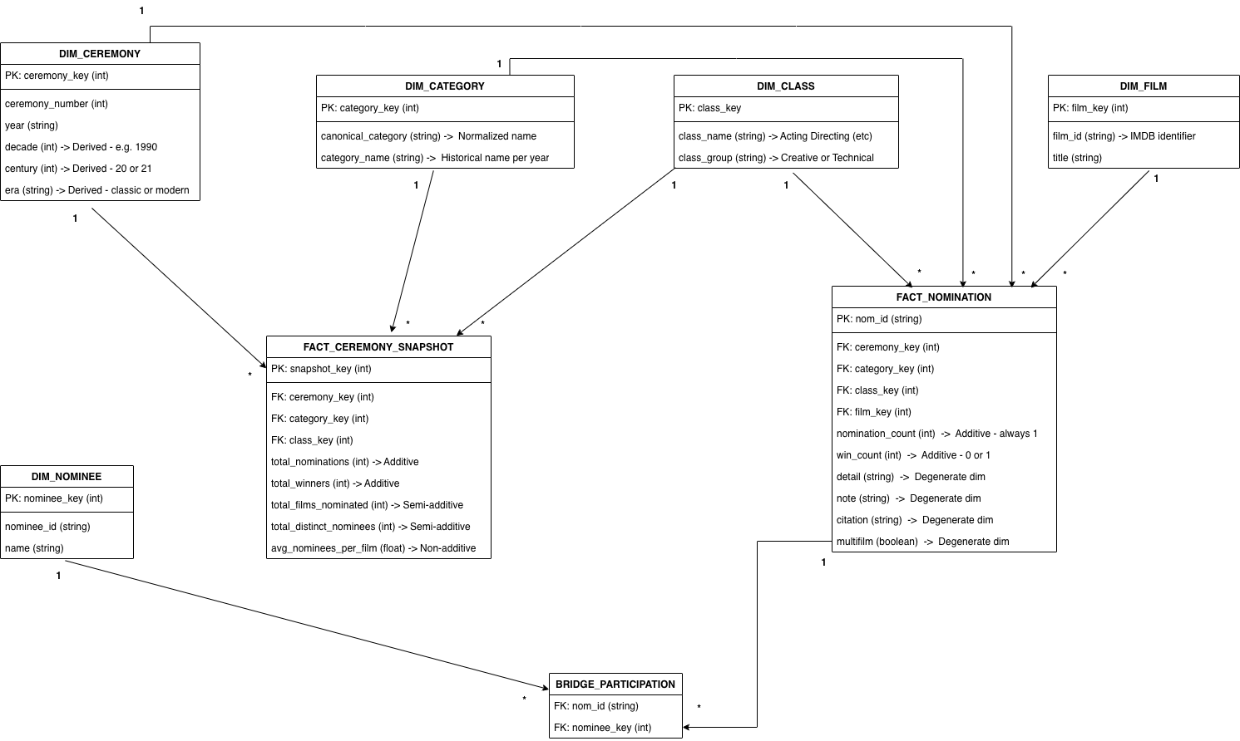
3 Star Schema Dimensional Model
2 fact tables · 5 conformed dimensions · 1 bridge · snapshot fact for instant aggregation
07

Slide 8
04 · ETL — Extract, Transform, Load
Full pipeline: CSV , Staging ,Operational ,Star Schema
01
02
03
04
EXTRACT
TRANSFORM
LOAD DIMS
LOAD FACTS
01_load.sql
02_create_load_tables.sql
Dimension tables
Fact & bridge tables
CSV → stg_oscars
16 raw columns
Bulk INSERT
No filtering
Winner normalisation
Year parsing & decade
Era classification
Surrogate keys
dim_ceremony
dim_category / class
dim_film · dim_nominee
DEDUPLICATED
fact_nomination
bridge_participation
fact_ceremony_snapshot
Indexes applied
KEY TRANSFORMATIONS
Winner Normalisation (null/0/1 → INT) · Year Parsing (SUBSTR → 4-digit) · Decade Derivation (/10)*10 · Class Grouping (Creative/Technical) · INSERT OR IGNORE Dedup · ROW_NUMBER() Surrogate Keys
08

Slide 9
05 · Querying & Data Analysis
15 analytical SQL queries — highlights from key findings
Q3 · MOST NOMINATED FILMS
Q9 · NOMINATIONS BY DECADE
Film | Nominations
A Star Is Born | 26
West Side Story | 18
Titanic | 16
Mutiny on the Bounty | 15
Moulin Rouge | 15
Gone with the Wind | 15
Little Women | 14
La La Land | 14
Cleopatra | 14
All about Eve | 14
Q8 · NOMINATIONS BY DECADE
Title | Nominations | Wins | Win Rate
A Star Is Born | 26 | 4 | 15.4%
West Side Story | 18 | 11 | 61.1%
Titanic | 16 | 12 | 75.0%
Mutiny on the Bounty | 15 | 1 | 6.7%
Gone with the Wind | 15 | 10 | 66.7%
09

Slide 10
05 · Querying & Data Analysis (cont.)
Win rates, class analysis & most decorated nominees
Q4 · TOP CATEGORIES
Q12 · CLASS WIN RATES
Q13 · TOP NOMINEES
Category | Nominations
BEST PICTURE | 601
MUSIC (Original Score) | 519
MUSIC (Original Song) | 475
DIRECTING | 471
FILM EDITING | 450
ACTRESS IN A SUPPORTING ROLE | 440
ACTOR IN A SUPPORTING ROLE | 440
WRITING (Original Screenplay) | 415
SHORT FILM (Animated) | 393
DOCUMENTARY (Short Subject) | 387
Class | Nominations | Win Rate
Production | 3222 | 21.2%
Title | 2706 | 21.1%
Acting | 1835 | 20.3%
SciTech | 890 | 100.0%
Special | 376 | 98.4%
Walt Disney
40.3%
25 wins / 62 nom.
Eastman Kodak
100%
15 wins / 15 nom.
Metro-Goldwyn-Mayer
19.1%
13 wins / 68 nom.
Alfred Newman
20.6%
7 wins / 34 nom.
10
⚠ SciTech 100% rte: honorary, non-competitive by definition

Slide 11
06 · Visualisation — Power BI Dashboard
7 charts across 2 report pages — bars, lines, donut, KPI cards
Chart 1
Top 10 Most Nominated Films
Chart 2
Nomination Wins by Decade
Horizontal bar — A Star Is Born has 26 nominations — highest ever — because it was made 4 times across different decades.
Clustered Bar Chart — The 1940s–1990s had the highest activity. films were nominated vs how many actually won across each decade
Chart 2
Chart 2
11

Slide 12
06 · Visualisation — Power BI Dashboard
7 charts across 2 report pages — bars, lines, donut, KPI cards
Chart 3
Chart 4
TOP Films: Nomination Vs Win Rate
Oscar Wins Over Time
Chart 4
Line & Stacked Column: Titanic (16 nominations, 75% win rate) is far more efficient than A Star Is Born (26 nominations, only 15.4% win rate
Line chart : Total number of Oscar wins given out each year from 1928 to 2023
12

Slide 13
06 · Visualisation — Power BI Dashboard
7 charts across 2 report pages — bars, lines, donut, KPI cards
Wins By Award Category
Win Rate by Production Company
Chart 5
Cluster Bar chart : Technical categories like Directing, Film Editing and Acting dominate showing the Academy values craft over commercial success
Chart 6
Cluster Bar chart : Walt Disney leads with 37.3% win rate — meaning more than 1 in 3 of their nominations result in a win. MGM and Warner Bros follow
13

Slide 14
07 · Conclusion & Critical Reflection
Key findings · DW advantages · Limitations · Future work
KEY FINDINGS
DW vs OLTP ADVANTAGES
★ Titanic — best single-film win rate (75%) — 12/16
★ 1940s nomination peak — WWII documentary surge
★ SciTech/Special awards distort competitive win-rate analysis
★ Modern era: higher win rate (30.1%) but less nominee diversity
★ Walt Disney — most decorated individual (25 wins, 62 noms)
Query Perf.: Snapshot pre-aggregation vs full JOIN of 11,874 rows
Analytical: Derived attrs (decade/era) computed once at ETL load
Conformed Dims: dim_ceremony shared across both fact tables
Separation: Operational integrity ≠ analytical model — no coupling
Power BI: Star schemas are the native model for Power BI engine
SHORTCOMINGS
FUTURE WORK
⚠ No incremental load — full ETL reload for each new ceremony
⚠ No Slowly Changing Dimensions — film/nominee history lost
⚠ Single data source — no box office, critic scores, streaming data
⚠ Winner encoding ambiguity — null/0/1/1.0 required CASE logic
⚠ SQLite lacks PIVOT, parallel execution, concurrent writes
⚠ Power BI built on flat staging table, not Star Schema
1. Connect Power BI directly to SQLite Star Schema via ODBC
2. Implement SCD Type 2 for dim_film & dim_nominee
3. Enrich dim_film with IMDb data: gross, genre, RT score
4. Add incremental ETL — append new ceremonies in minutes
5. Python-based predictive visuals for win probability forecasting
14

Slide 15
Thank You
Group G06 · Course: Data Warehouse · April 2026
David Pereira Dias · Manju Srinivasan · Miguel Filipe Santos

